Slide 1
ERD(ENTITY RELATIONSHIP DIAGRAM)

Slide 2
Outline:
What Entity relationship diagrams (ERD) are.
What Entities in an ERD are?
What Attributes in an ERD are?
What Relationships in an ERD are?
How to start an ERD .

Slide 3
ERD
Entity-Relationship Diagram (ERD) is a graphical representation of a Entity-Relationship Model.
The purpose of an ERD is to capture the richest possible understanding of the meaning of data necessary for an information system or organization.
ERDs are made from Entities, Attributes, and Relations.

Slide 4
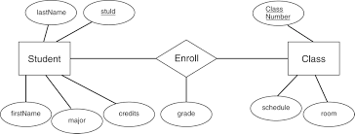
University Entity-Relationship Diagram

Slide 5
Entity
What is an Entity?
Has its own identity that distinguishes it from other entities.
Examples:
Person: PROFESSOR, STUDENT
Place: STORE, UNIVERSITY
Object: MACHINE, BUILDING
Event: SALE, REGISTRATION
Concept: ACCOUNT, COURSE

Slide 6
Entity (Entity Type vs. Entity Instances)
Entity Type is a collection of entities that share common properties or characteristics.
Entity Instance is a single occurrence of an entity type.
Entities should always be placed in a rectangle!
STUDENT
CLASS
PROFESSOR
STUDENT

Slide 7
Entity Types (Naming Guidelines)
Entity type name should be:
A singular noun and in capital letters.
Descriptive and specific to the organization.
Concise.

Slide 8
Attributes
Each Entity has a set of Attributes
Attribute is a property or characteristic of an entity that is of interest to the organization.
Example:
STUDENT: Student_ID, Student_Name, Phone_Number, Major

Slide 9
Attributes
Student
Student_ID
Student_Address
Student_Phone

Slide 10
Attributes (Naming Guidelines)
An attribute name:
Should be a noun and capitalize the first letter of each word. (Example: Student_ID.)
Should be unique.
Should follow a standard format. (Example: Student_GPA)
Similar attributes of different entity types should use similar but distinguished names.
Example: Faculty_Residence_City_Name and Student_Residence_City_Name

Slide 11
There are four types of attributes:
1. Key attribute
2. Composite attribute
3. Multivalued attribute
4. Derived attribute

Slide 12
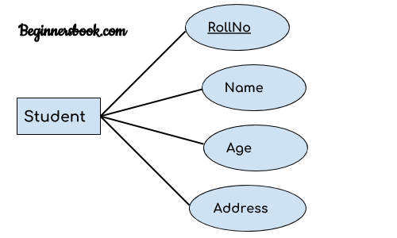
1. Key attribute:
A key attribute can uniquely identify an entity from an entity set.
For example, student roll number can uniquely identify a student from a set of students.
Key attribute is represented by oval same as other attributes however the text of key attribute is underlined.

Slide 13
Criteria for Selecting Attributes
Choose a candidate key that will not change its value.
Choose a candidate key that has valid values and not be null.

Slide 14
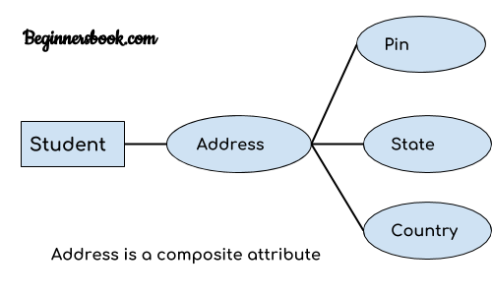
2. Composite attribute:
An attribute that is a combination of other attributes is known as composite attribute.
For example, In student entity, the student address is a composite attribute as an address is composed of other attributes such as pin code, state, country.

Slide 15
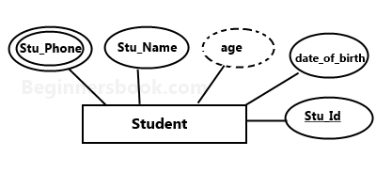
3. Multivalued attribute:
An attribute that can hold multiple values is known as multivalued attribute.
It is represented with double ovals in an ER Diagram.
For example – A person can have more than one phone numbers so the phone number attribute is multivalued.
4. Derived attribute:
A derived attribute is one whose value is dynamic and derived from another attribute.
It is represented by dashed oval in an ER Diagram.
For example – Person age is a derived attribute as it changes over time and can be derived from another attribute (Date of birth).

Slide 16
Relationships
Relationships are associations between one or more entity types.
The degree of a relationship = is the number of entity types that participate in a relationship.
There are 4 common relationships:
1. One to One 2. One to Many 3. Many to One 4. Many to Many

Slide 17
Relationships (Naming Guidelines)
A relationship/Cardinality name should:
Be a verb phrase, such as Is_assigned_to.
Avoid vague names, such as “Has”.

Slide 18
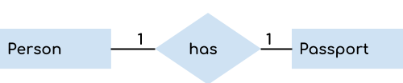
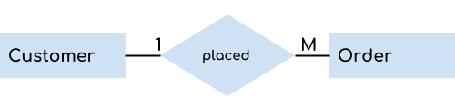
1. One to One Relationship
When a single instance of an entity is associated with a single instance of another entity then it is called one to one relationship.
For example, a person has only one passport and a passport is given to one person.
2. One to Many Relationship
When a single instance of an entity is associated with more than one instances of another entity then it is called one to many relationship.
For example – a customer can place many orders but a order cannot be placed by many customers.

Slide 19
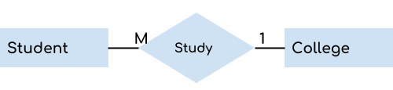
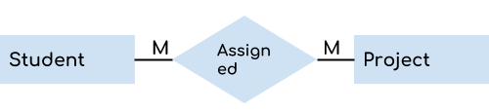
3. Many to One Relationship
When more than one instances of an entity is associated with a single instance of another entity then it is called many to one relationship.
For example – many students can study in a single college but a student cannot study in many colleges at the same time.
4. Many to Many Relationship
When more than one instances of an entity is associated with more than one instances of another entity then it is called many to many relationship.
For example, a can be assigned to many projects and a project can be assigned to many students.

Slide 20
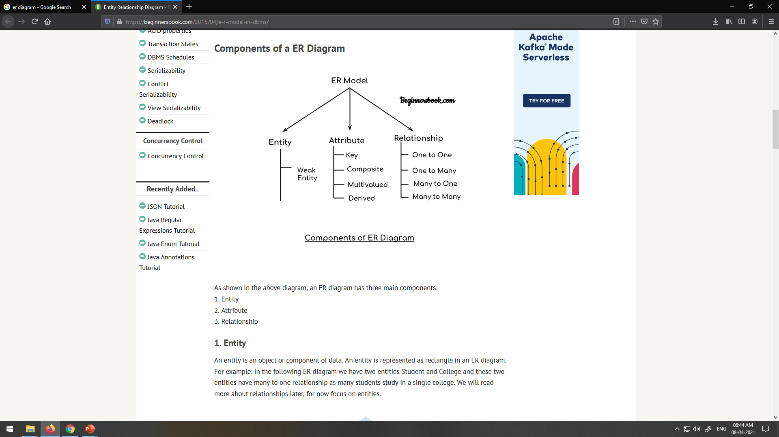

Slide 21
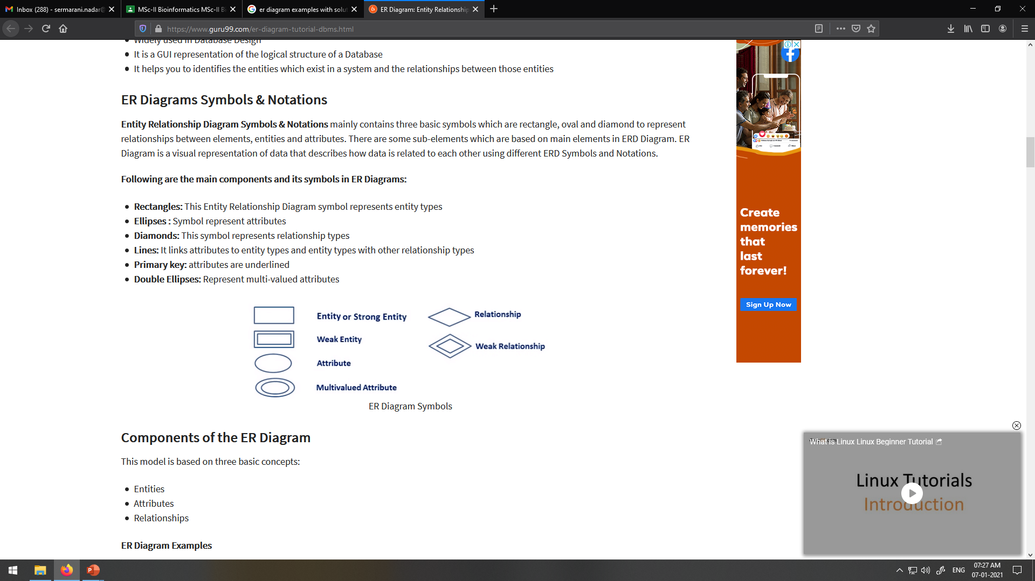

Slide 22

Questions over ERD?

Slide 23
QUESTIONS
Define the Entities.
Define the Relationships.
How to Add attributes to the relationships.
How to Add cardinality to the relationships.

Slide 24
H/W:
DRAW ER DIAGRAM FOR HOSPITAL MANAGEMENT SYSTEM
ENTITIES ARE PATIENT,HOSPITAL,DOCTOR,REPORTS

Slide 25
Draw ER diagram for Exam database Entities are Student,Exam,Results C/W: Draw ER DIAGRAM for company database ,Entities are Login,employee,department

Slide 26
